Slide 1
NASA SPACE APPS CHALLENGE-2018
MARTIAN’S EYE
( A device developed to track atmospheric changes on Mars)
Presented by: ‘De-Coders’
SRI INDU COLLEGE OF ENGG. AND TECH.

Slide 2
CHALLENGE:
Develop a sensor to be used by humans on Mars.

Slide 3
PROBLEMS:
It’s only a matter of time before we are able to go to Mars and see, touch and inspect things that have only been visible through the lenses of landers, rovers, and orbiters.
The rovers and orbiters currently hovering over Mars are not solidly reliable, moreover there are certain parameters which are quite essential for human existence on Mars which are not properly studied by these devices.
We need sophisticated device boarded reliable sensors so that we will have the opportunity to build upon decades of past science experiments from robotic missions, and we will explore familiar and new terrains and environments on Mars in person.

Slide 4
THE MARTIAN’S EYE:
To overcome this problem, our team came up with a subtle solution wherein we use Raspberry Pi and related concepts to solve this issue.
We use the Raspberry Pi camera module (v 1.3) which is mounted over the device itself.
We also use an object detection sensor and also a temperature sensor which is an added feature which we provide to keep a log of temperature and also hindrances.
We use SHT20 I2C for temperature and humidity sensor which is an equipped water-proof sensor which send all the reports to NASA base station through RF signals.

Slide 5
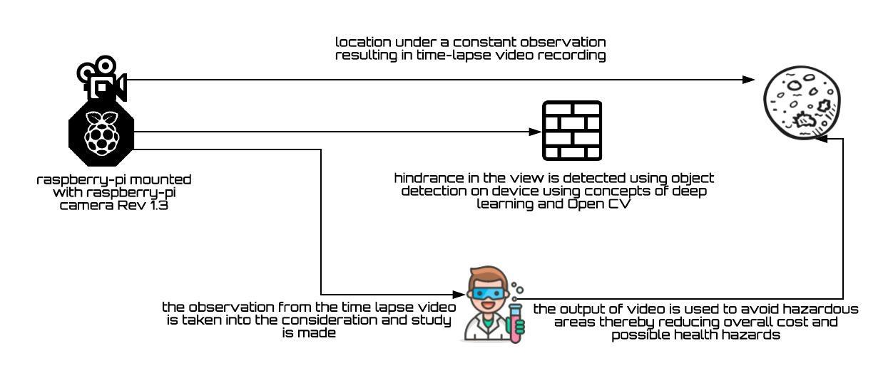
CASE STUDY AND UML DIAGRAM:

Slide 6
TECHNOLOGICAL STACK:
Hardware Components:
Raspberry Pi
Raspberry Pi mounted camera module rev1.3
SHT20 I2C temperature & humidity sensor
Software Components:
ImageMagick
Aurdino
Python 3 (IDLE)
Open CV

Slide 7
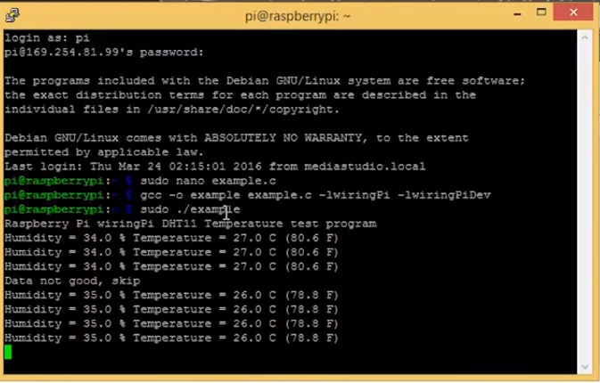
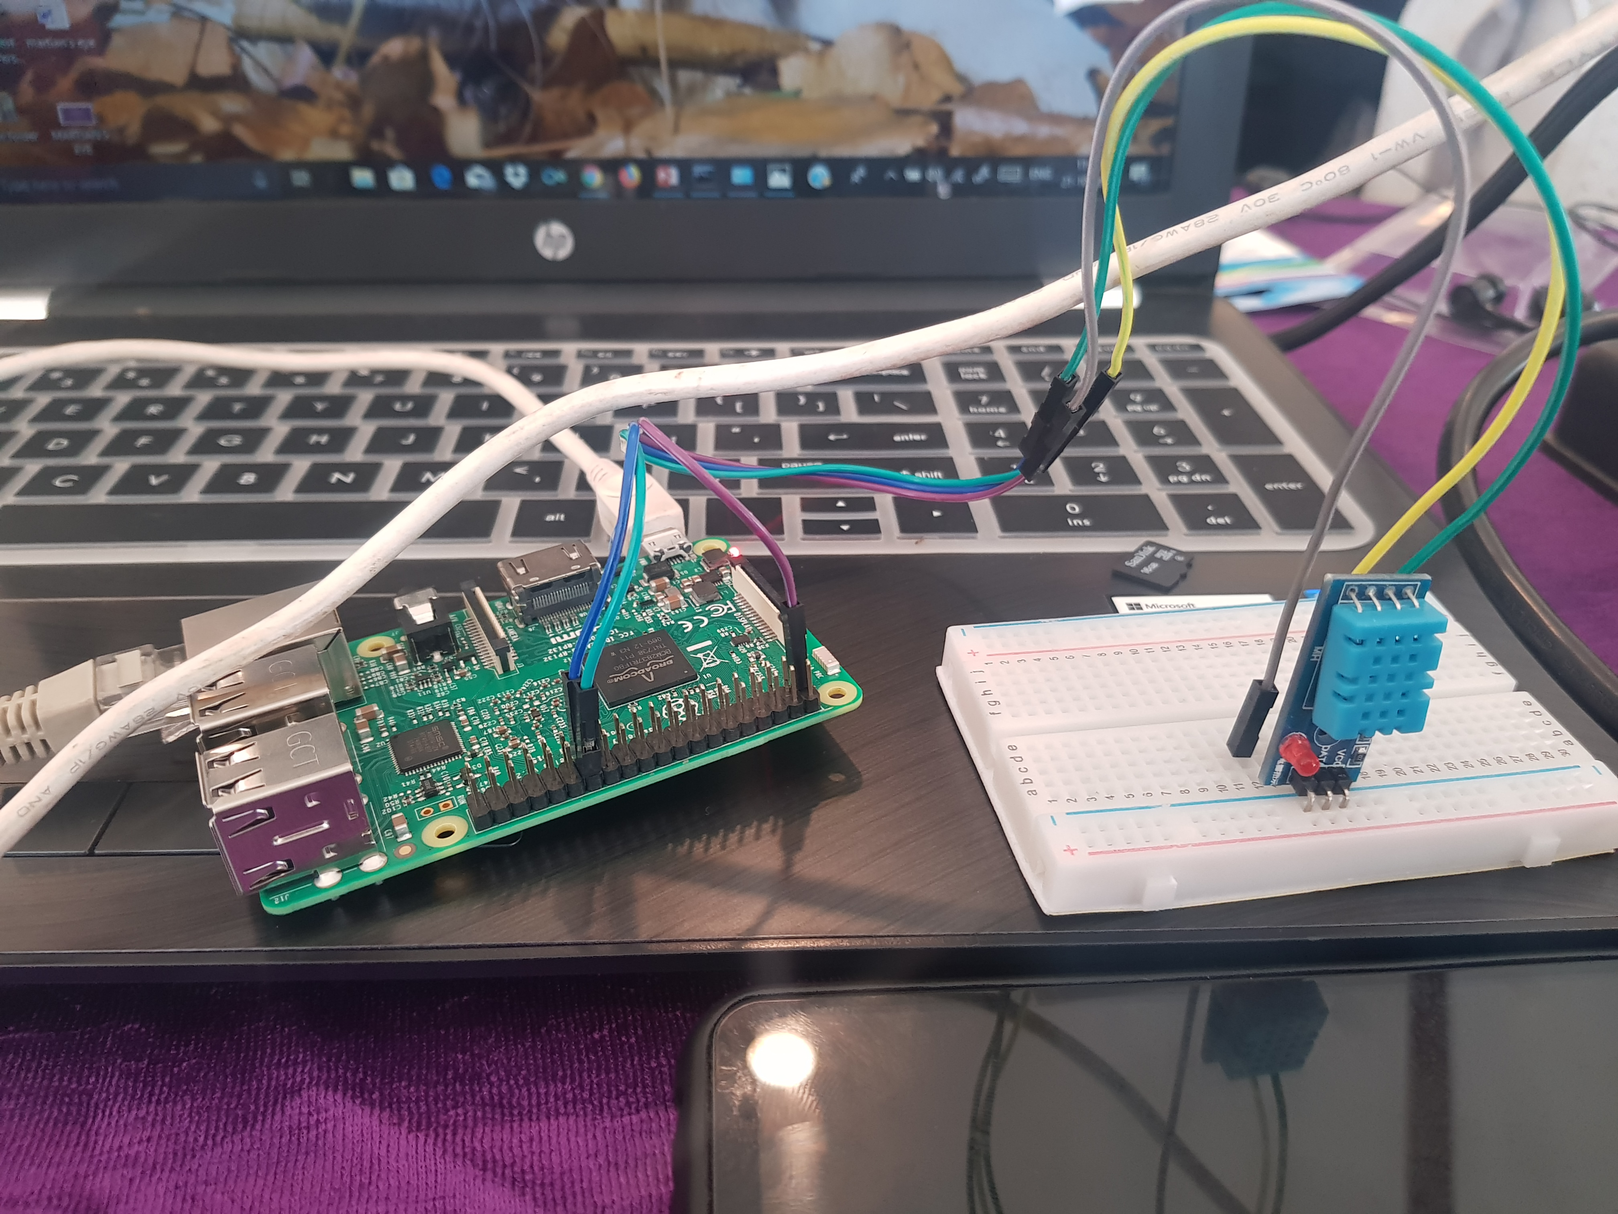
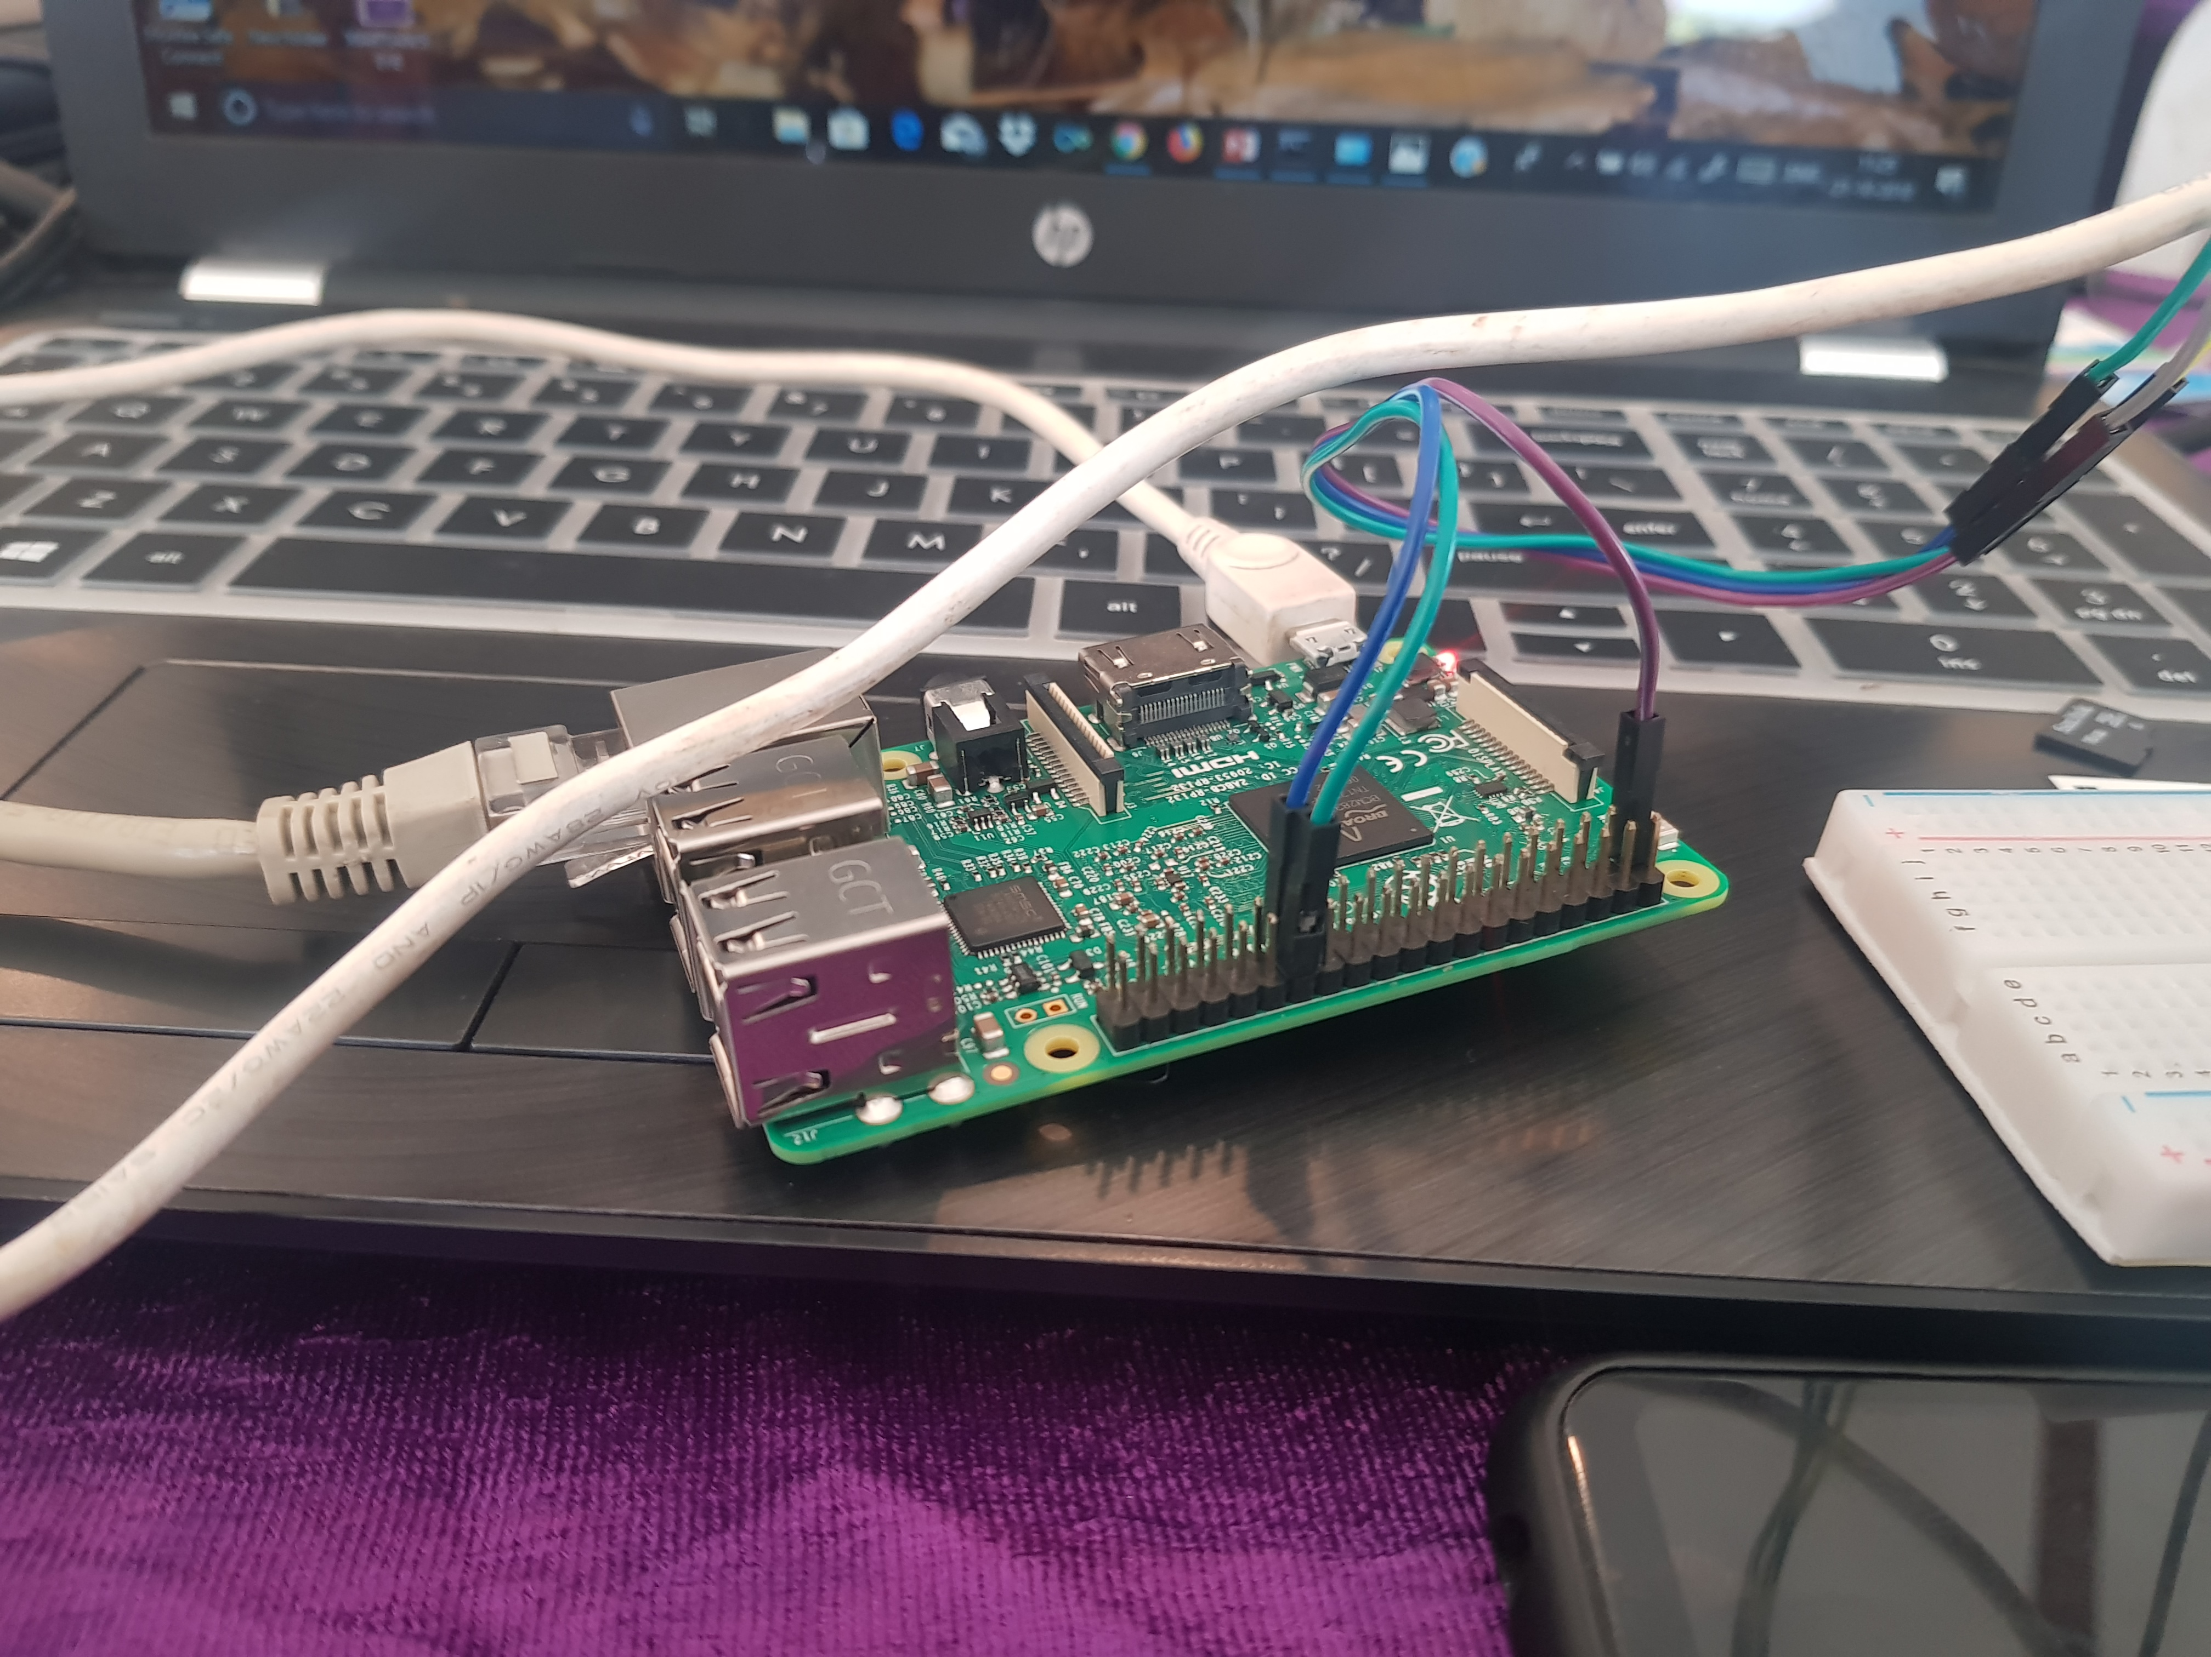

Slide 8
DEPENDENCIES:
Deployment of the device is crucial.
No interruption of signals should occur.
Number of preliminary tests should be conducted at the research centre before deploying the device on the planet.
Sensors should be properly protected and care is to be taken that they are not in any case damaged before deploying.

Slide 9


